Slide 1
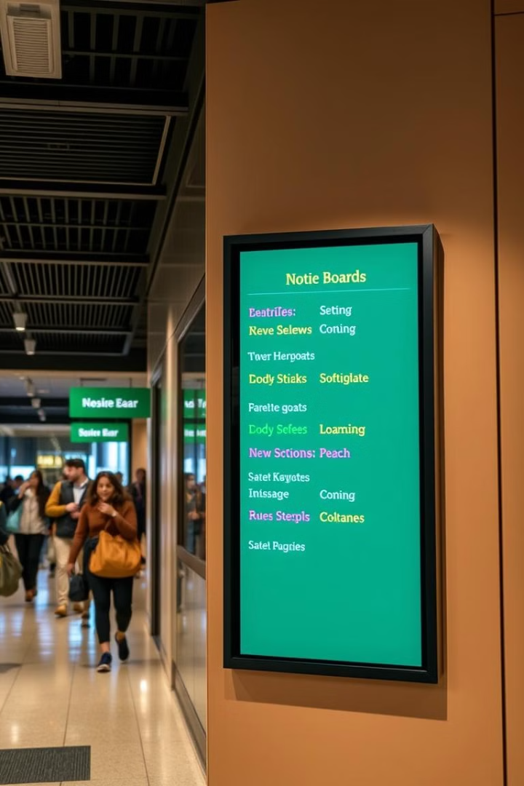
Smart Notice Board using Microcontroller (EDSim51)
Innovative digital display system for real-time information dissemination.
Team members:-
1032230313-12-Naman Bhansali.
1032231187-36-Anjali Singh.
1032231210-38-Akansha Jain.
1032231221-40-Aaditi Salunkhe.
1032231290-47-Shloka Shetty.

Slide 2
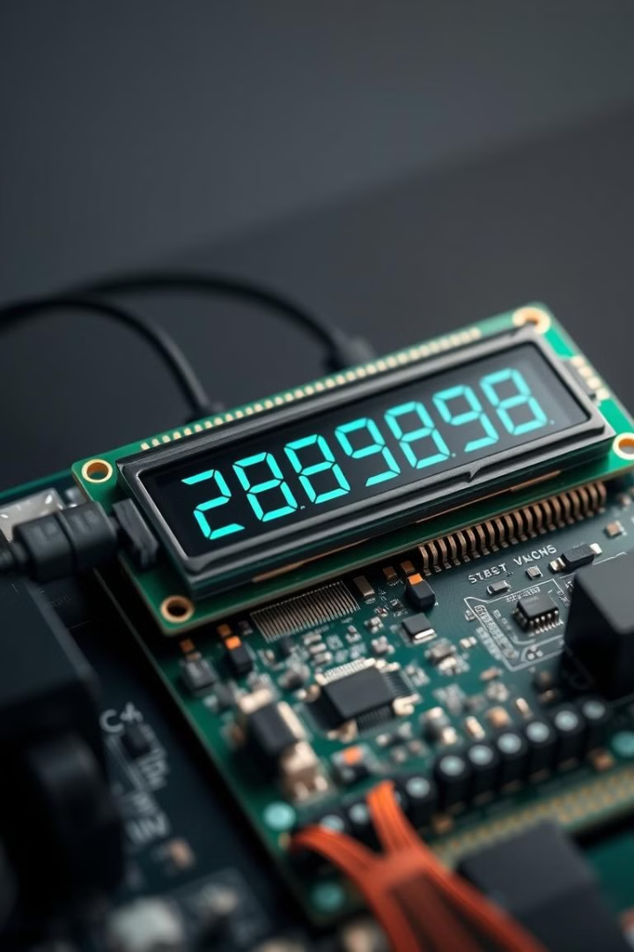
Introduction
Objective
1
Design notice board using 8051 microcontroller in EDSim51 simulator.
Use Case
2
Real-time message display without manual input.
Application
3
Useful in schools, offices, and public places.

Slide 3
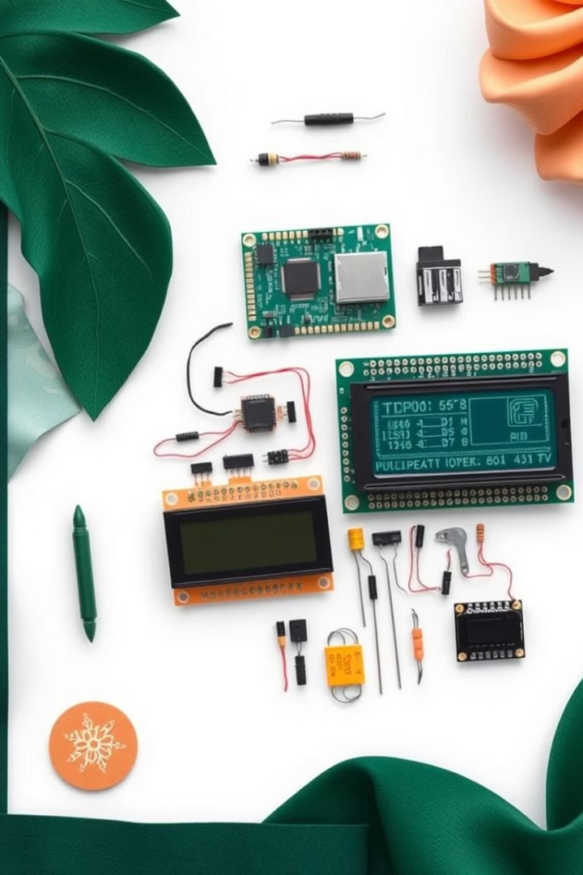





Components Used
8051 Microcontroller
Heart of the system, controls all operations.
16x2 LCD Display
Outputs visual information to users.
EDSim51 Simulator
Software environment for development and testing.
Basic Components
Pull-up resistors and power supply included.

Slide 4
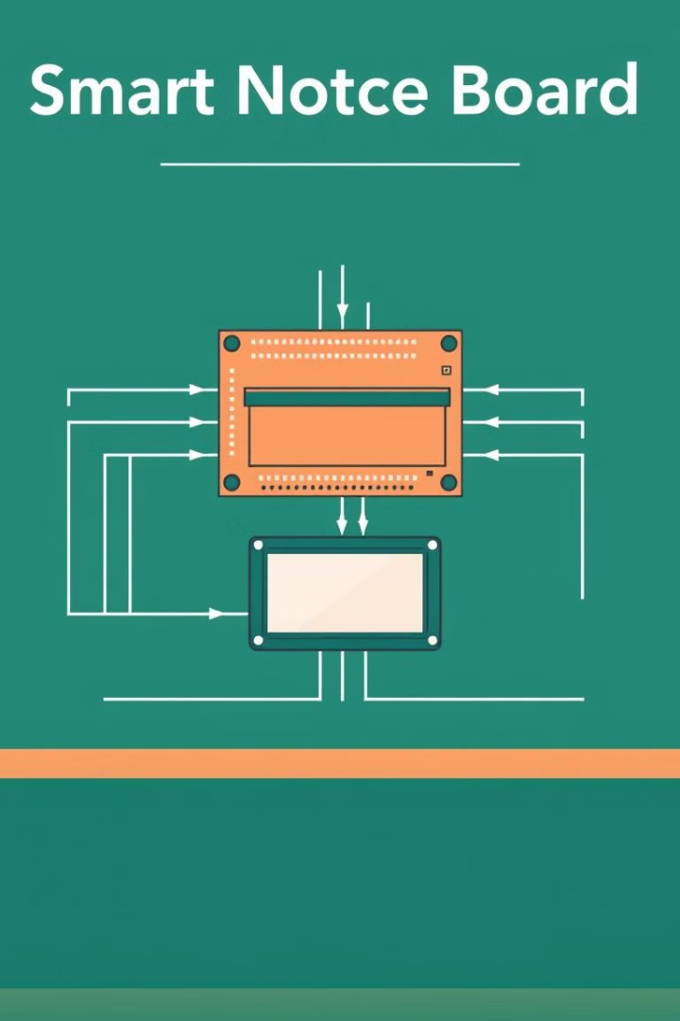



System Architecture
Microcontroller
Processes data and controls system operations.
Interfacing
4-bit/8-bit communication with LCD.
LCD Display
Shows messages stored in Look-Up Tables (LUTs).

Slide 5
Software Design
Programming Language
Simulation Tool
Key Subroutines
Assembly used for efficient microcontroller control.
EDSim51 provides virtual environment for testing.
LCD initialization, display control, cursor positioning implemented.

Slide 6
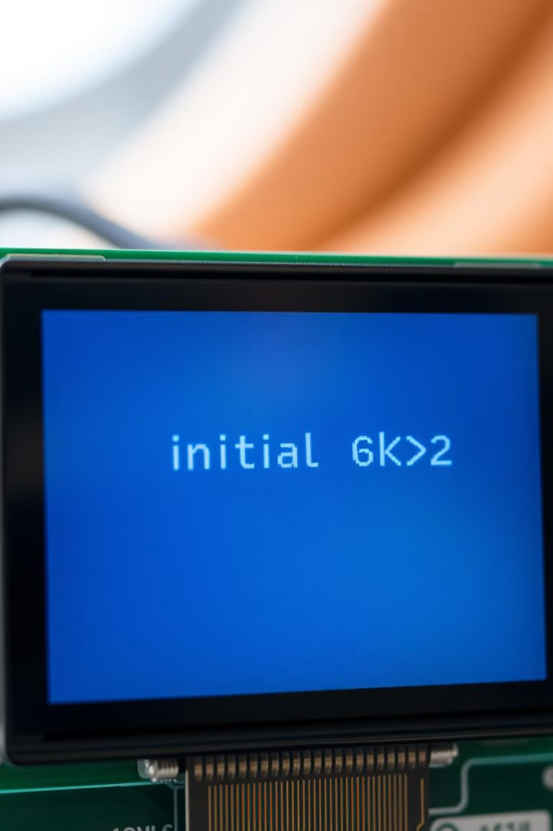
Code Explanation (LCD Control)
Initialization
1
Set 4-bit mode for efficient data transfer.
Display Control
2
Enable cursor blinking for visual feedback.
Message Display
3
Retrieve from LUTs, show line-by-line.

Slide 7
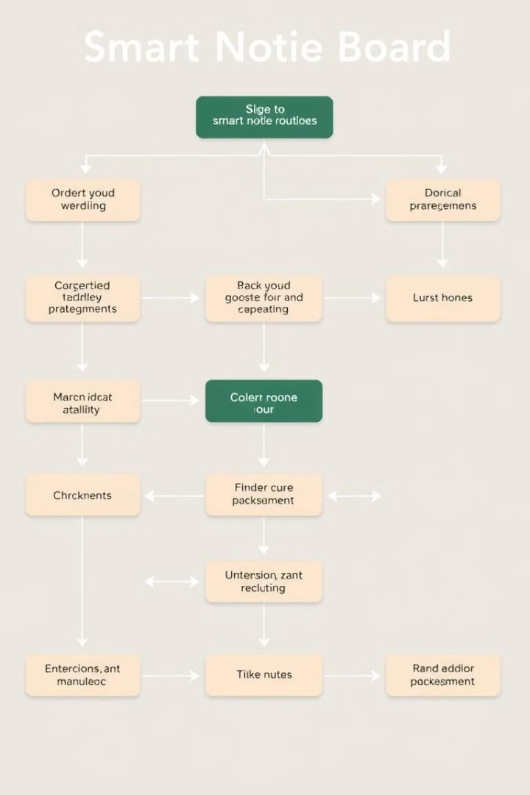

Key Subroutines
FuncSet
Configures LCD mode (4-bit interface)
DispCon
Controls display and cursor visibility
EntryMode
Manages cursor movement and address increment
SendChar
Transmits data to LCD
Delay
Ensures proper timing between operations

Slide 8
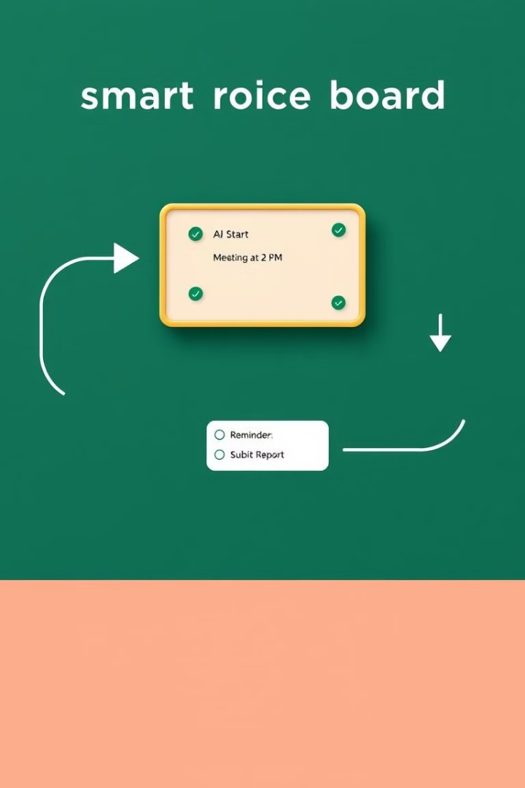




Program Flow
Start
Power on and initialize system.
LCD Initialization
Configure display settings and modes.
Display Messages
Show first line, set cursor, show second line.
Loop
Continually update display as needed.

Slide 9
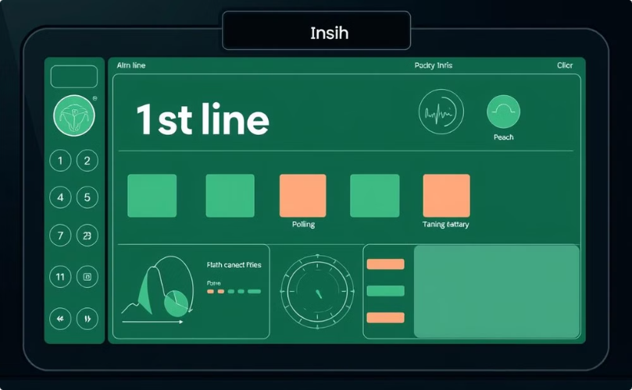
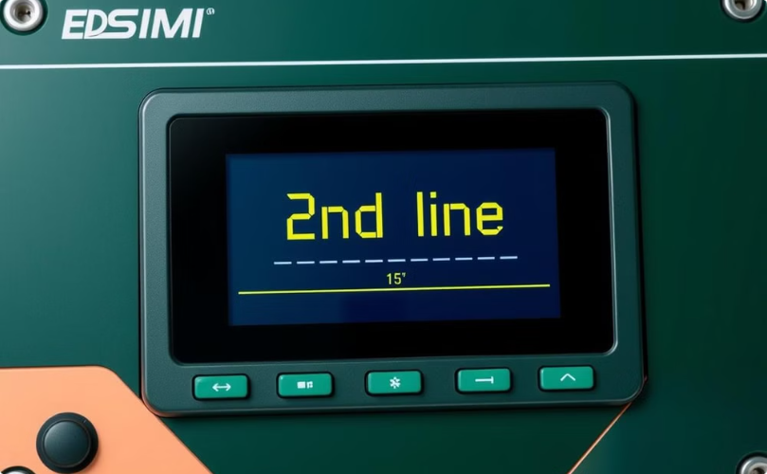
Simulation Output
First Line Display
Second Line Display
Shows "1st line" on top row.
Displays "2nd line" on bottom row.

Slide 10
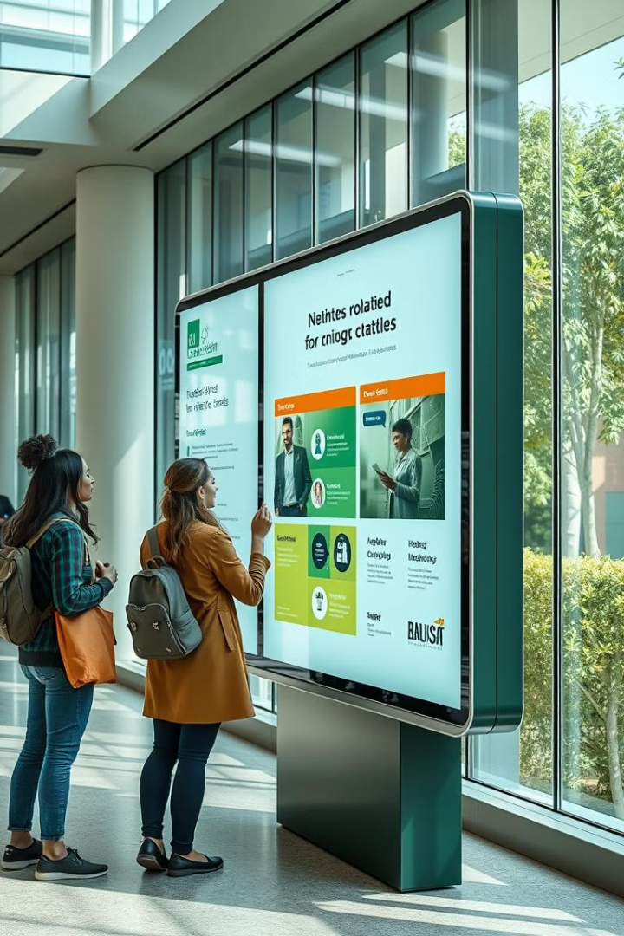
Conclusion
Achievements
Successful implementation of smart notice board using EDSim51.
Applications
Versatile use in educational, professional, and public settings.
Future Enhancements
Potential for wireless connectivity and dynamic content updates.

Slide 11
Thank You !

